Slide 1
T O O L S - U S E D
Supporting file:- link
Tableau used for EDA Visualization
Tableau Public Link -
https://public.tableau.com/app/profile/rahul.jha6809/viz/Rahul_jha_MRAProject-Milestone2/Quartlyvsorder?publish=yes
KNIME Workflow used for MBA Analysis
knime://LOCAL/MRA%20Project%20-%20Milestone%202

Slide 2
Problem statement:- A grocery store shared the transactional data with you. Your job is to identify the most popular combos that can be suggested to the grocery store chain after a thorough analysis of the most commonly occurring sets of items in the customer orders. The store doesn’t have any combo offers. Can you suggest the best combos & offers? We aim to Analysis the association rules to suggest the best combo and offers for the grocery store chain using market basket analysis. The data provided in the csv file has a point of sale (POS)
AGENDA

Slide 3
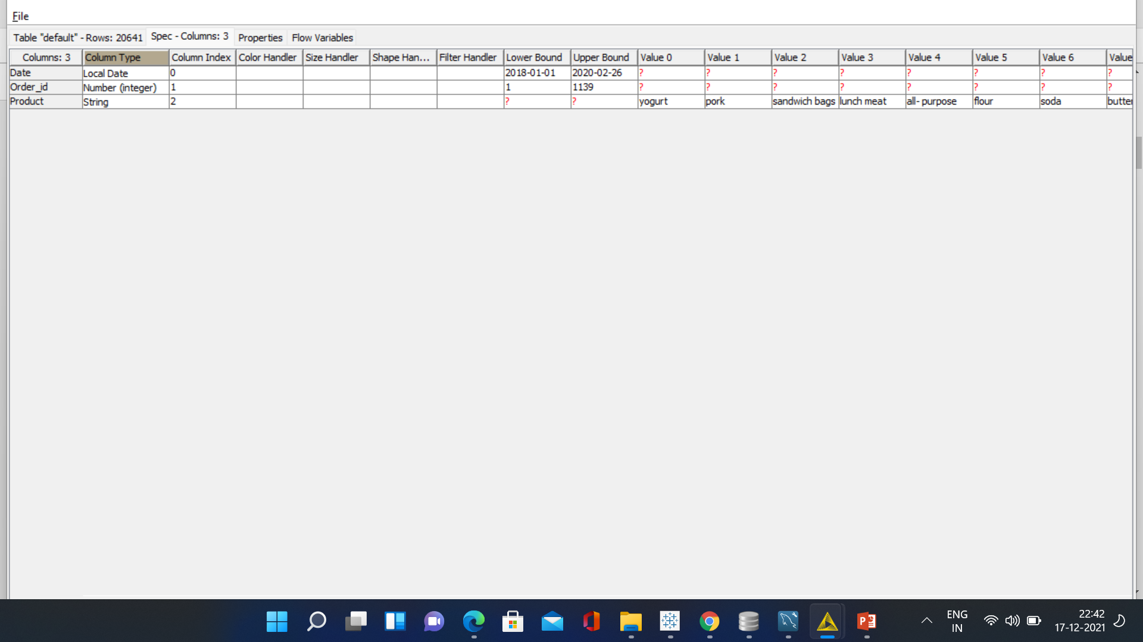
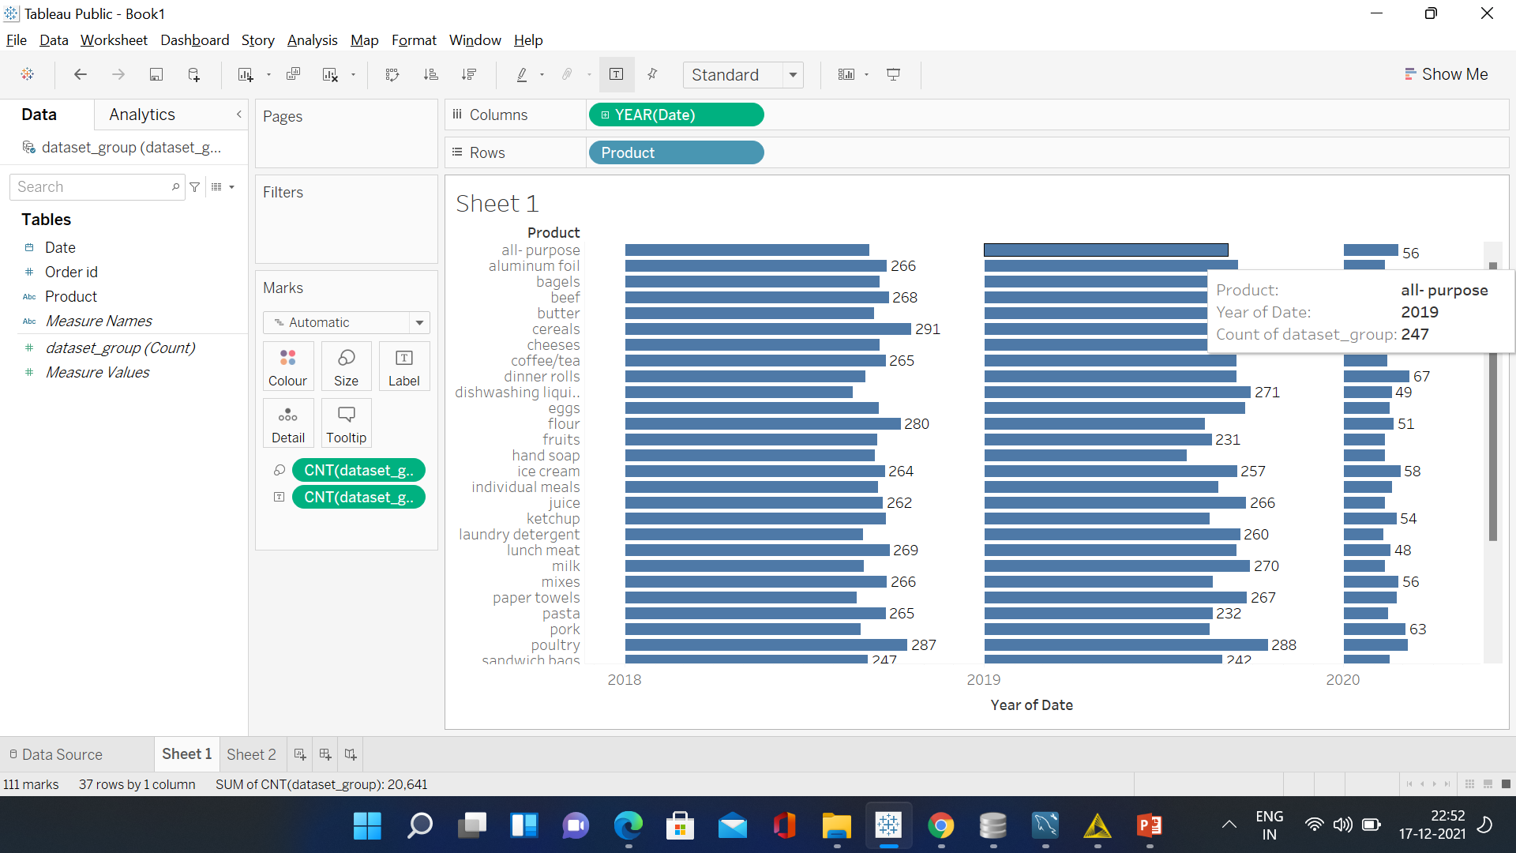
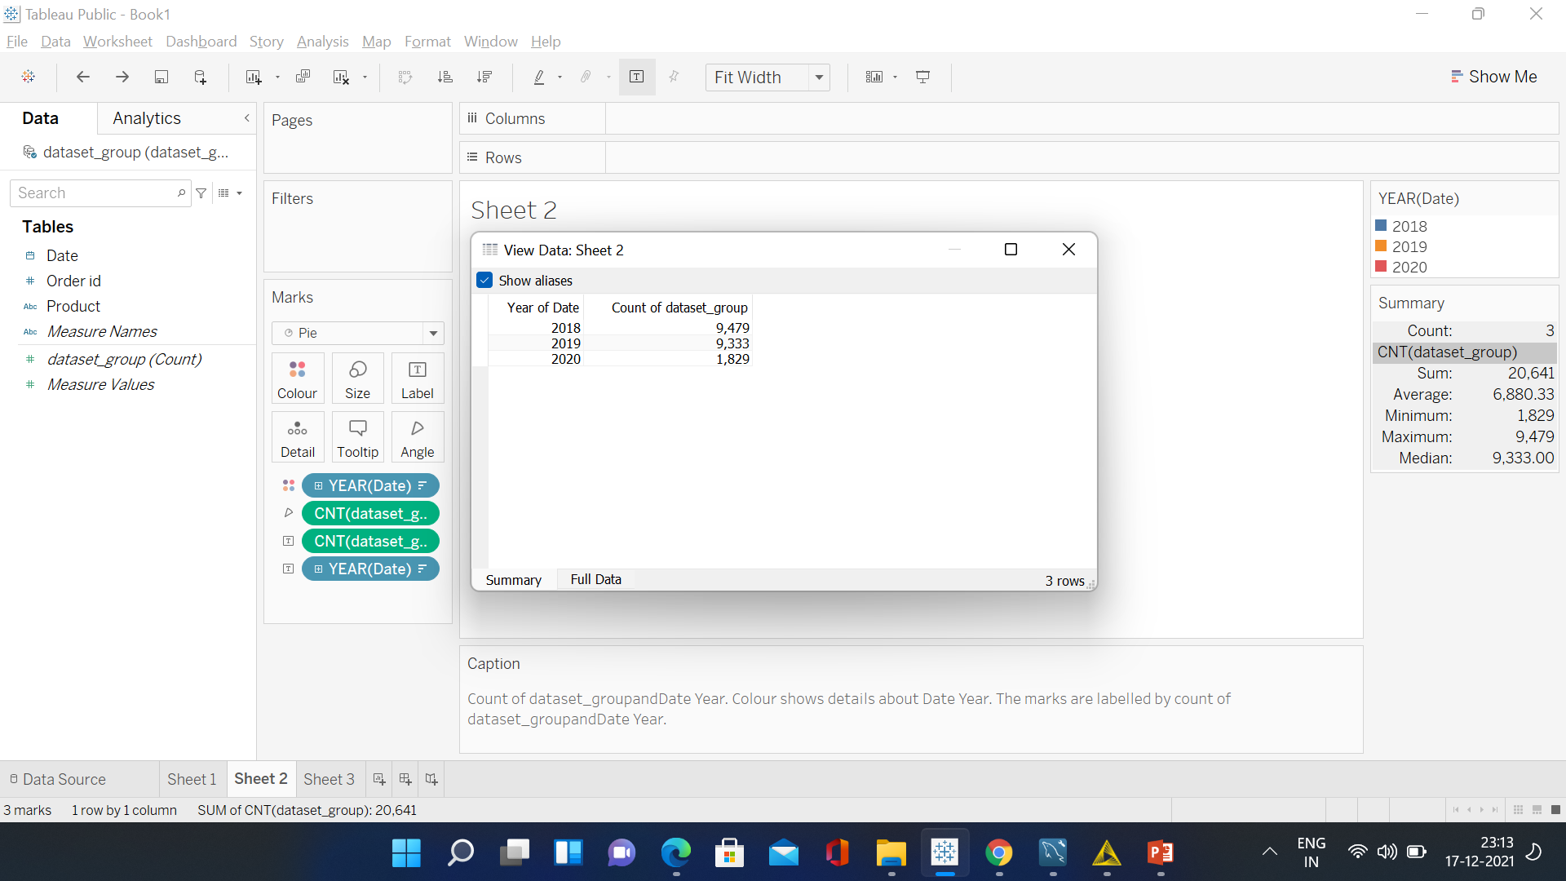
A B O U T -DATA
DATA DICTIONARY INFORMATION & ASSUMPTIONS
No of transactions : 20641
No of features : 3
Missing values :0
Duplicates :0
Data provided from Jan to Sep for 2 years (2018, 2019) and 2020 with 2 months(Jan and Feb) .

Slide 4
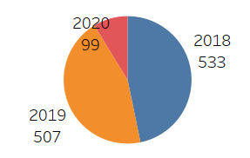
YEARLY- TREND
The year 2018 has the highest no of orders followed by 2019, Since the data in the year 2020 has only 2 months so very low count in orders

Slide 5
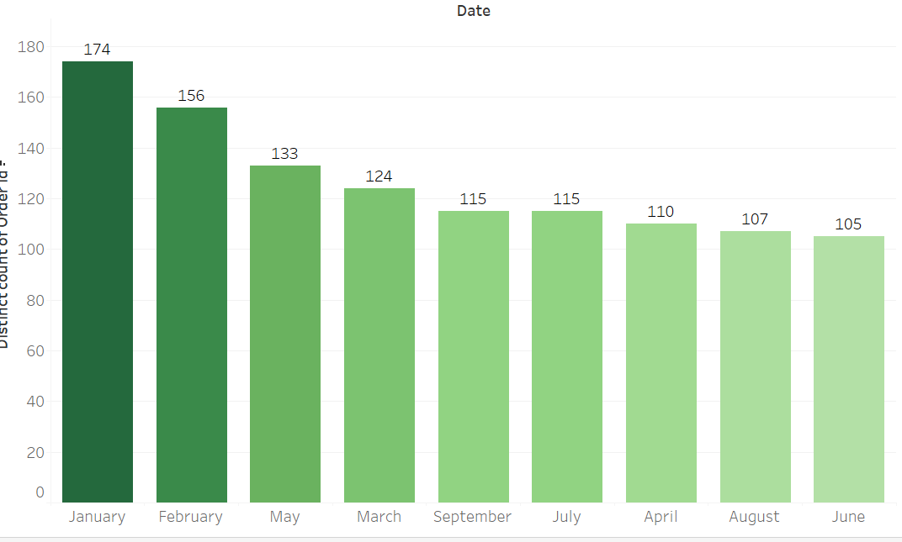
OVERALL- MONTHLY
There is highest no of unique orders in Jan(174) and low number of orders made in June(105).

Slide 6
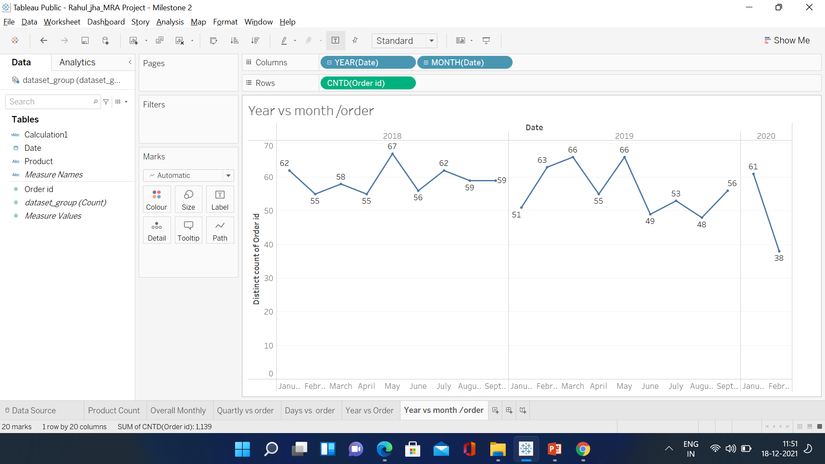
YEARLY / MONTHLY- TREND
There is no trend and seasonality available in the data provided .

Slide 7
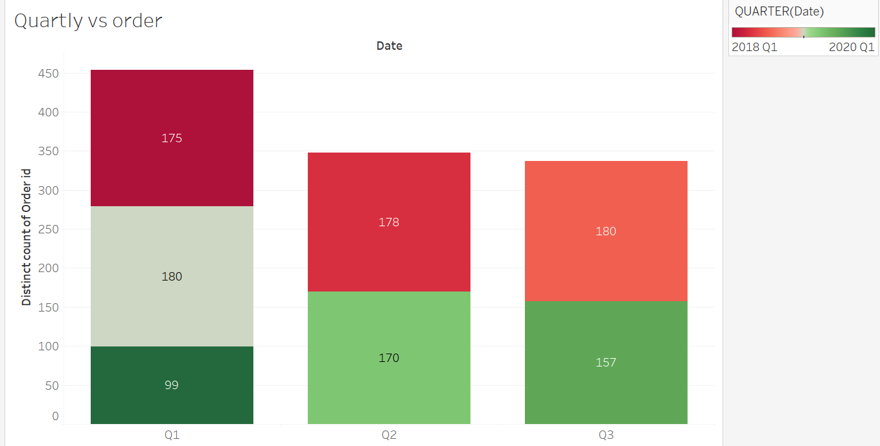
Q U A R T E R LY -T R E N D
The Q1 2019 and Q3 2018 have the highest no of orders (180) and the lowest no of orders in Q1 2020 since it contains only 2 months of data .

Slide 8
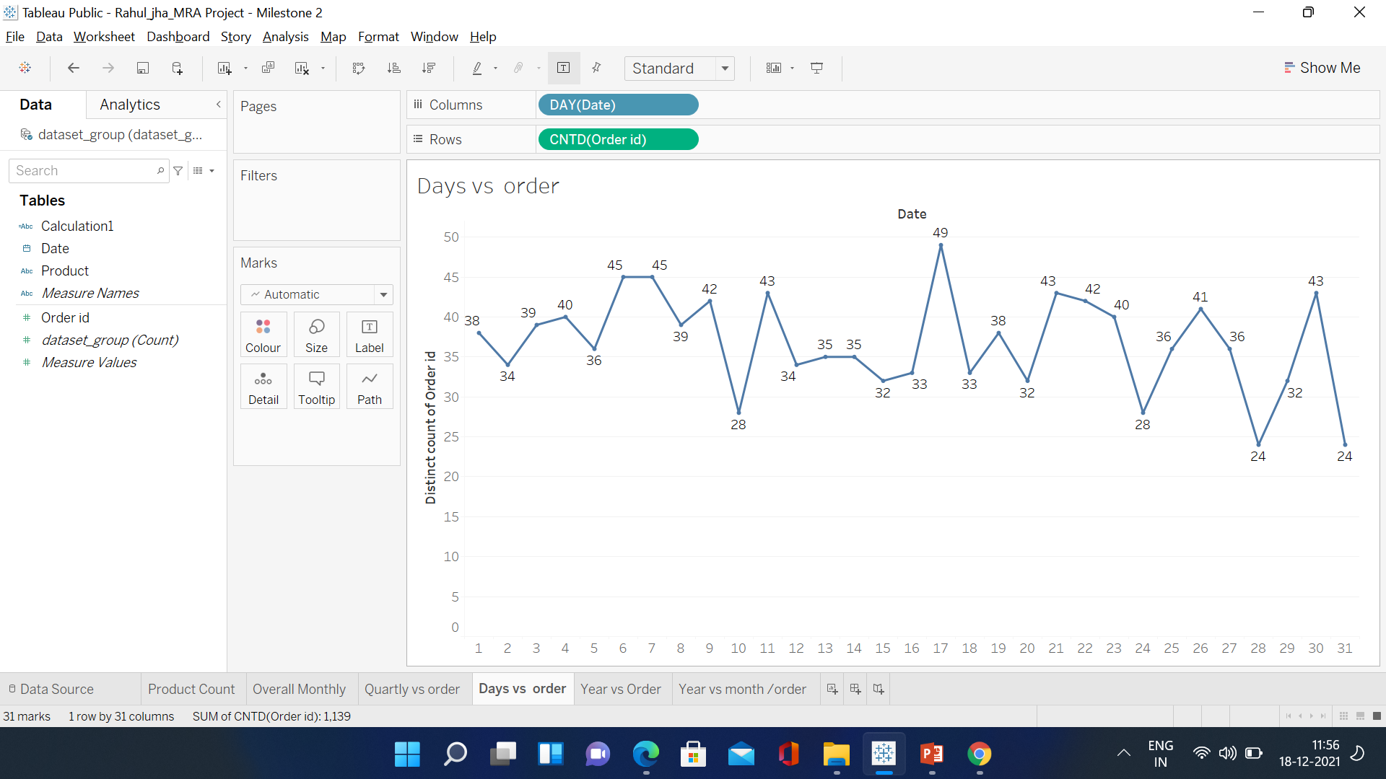
DAYWI S E -T R E N D
High number of orders made on mid of the month and start of month is low and it reduced at end of month .

Slide 9
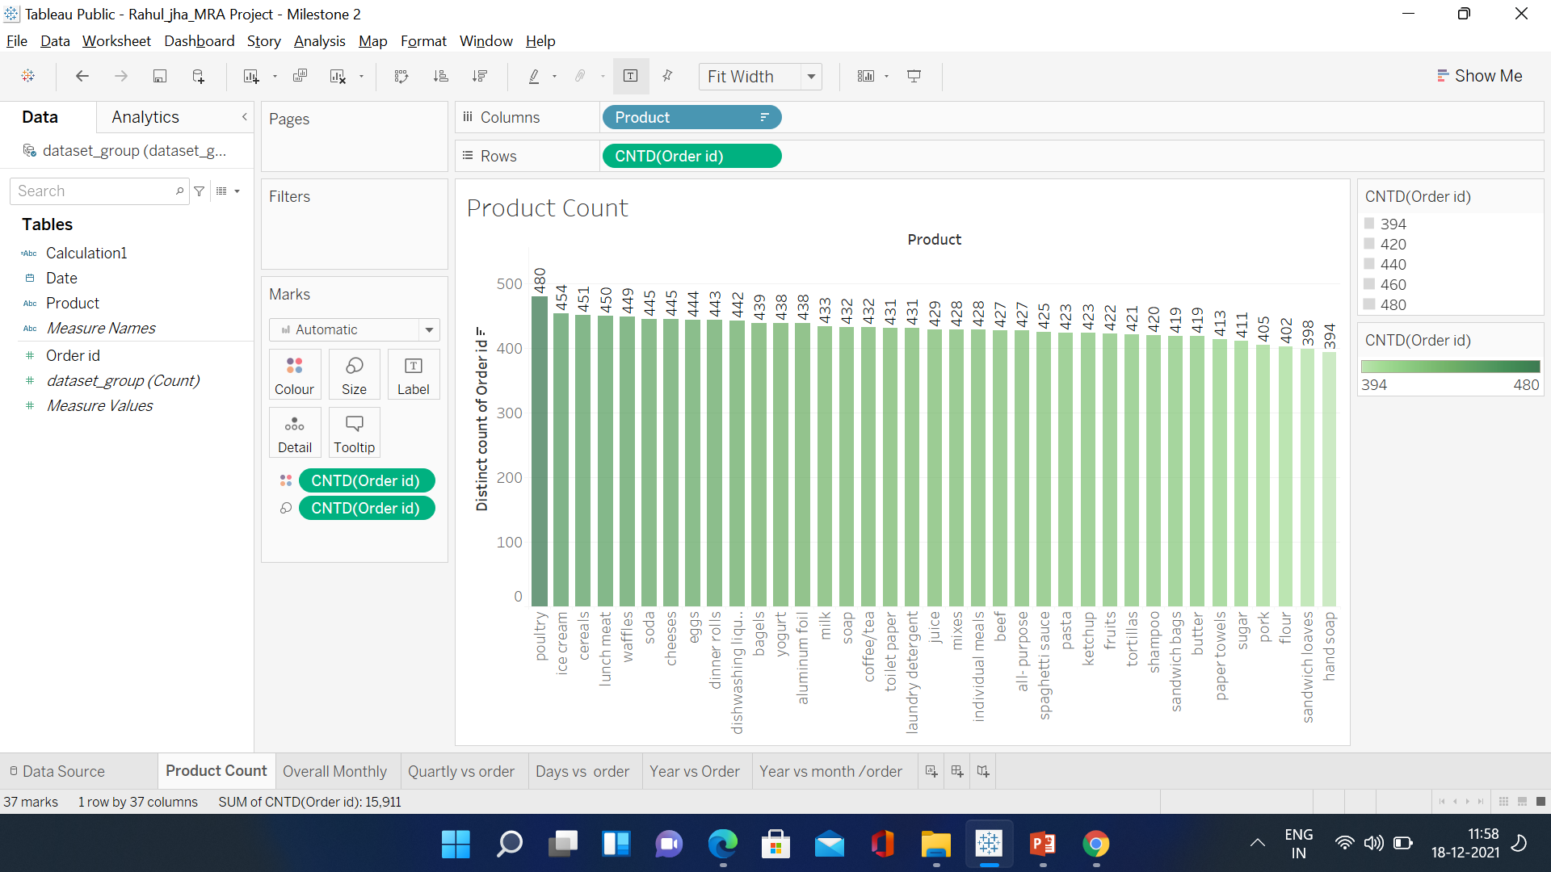
P R O D U C T S- C O U N T
The product poultry is the order highest no of orders and hand shop is the lowest no of orders .

Slide 10
P R O D U C T S – C O U N T
Product Distinct count of Order id yogurt 438 waffles 449 tortillas 421 toilet paper 431 sugar 411 spaghetti sauce 425 soda 445 soap 432 shampoo 420 sandwich loaves 398 sandwich bags 419 poultry 480 pork 405 pasta 423 paper towels 413 mixes 428 milk 433 lunch meat 450 laundry detergent 431 ketchup 423 juice 429 individual meals 428 ice cream 454 hand soap 394 fruits 422 flour 402 eggs 444 dishwashing liquid/detergent 442 dinner rolls 443 coffee/tea 432 cheeses 445 cereals 451 butter 419 beef 427 bagels 439 Aluminium foil 438 all- purpose 427 | All Purpose is general product so we will remove the data to get better combos. Unique Products count post removal of All-Purpose – 15,484/- Products counts post removal of All-Purpose – 20,090 /-

Slide 11
MA R KE T B A S K E T A N – A LY S I S
Market Basket Analysis is a technique which identifies the strength of association between pairs of products purchased together and identify patterns of co-occurrence. A co- occurrence is when two or more things take place together.
Market Basket Analysis creates If- Then scenario rules, for example, if item A is purchased then item B is likely to be purchased. The rules are probabilistic in nature or, in other words, they are derived from the frequencies of co-occurrence in the observations. Frequency is the proportion of baskets that contain the items of interest. The rules can be used in pricing strategies, product placement, and various types of cross-selling strategies. In order to make it easier to understand, think of Market Basket Analysis in terms of shopping at a supermarket. Market Basket Analysis takes data at transaction level, which lists all items bought by a customer in a single purchase. The technique determines relationships of what products were purchased with which other product(s). These relationships are then used to build profiles containing If-Then rules of the items purchased. The rules could be written as If {A} Then {B} .
The If part of the rule (the {A} above) is known as the antecedent and the THEN part of the rule is known as the consequent (the {B} above).
The antecedent is the condition and the consequent is the result. The association rule has three measures that express the degree of confidence in the rule, Support, Confidence, and Lift.

Slide 12
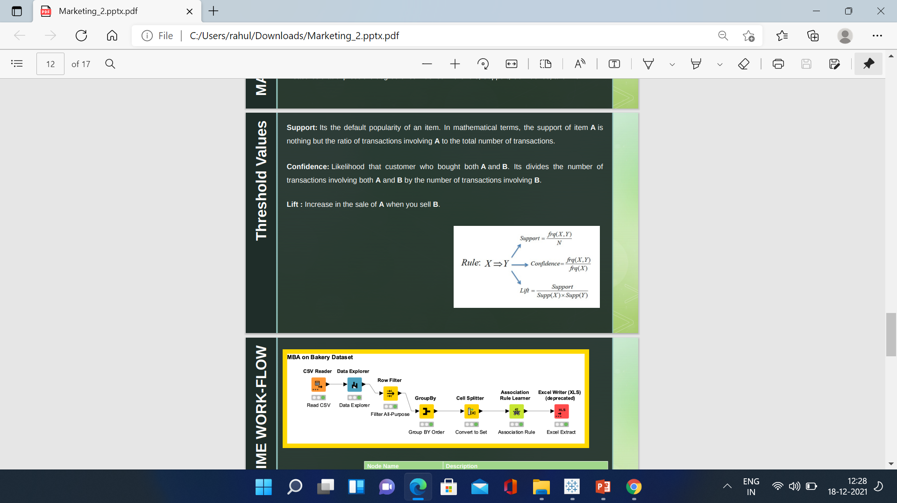
THRESHOLD – VA L U E S
Support: Its the default popularity of an item. In mathematical terms, the support of item A is nothing but the ratio of transactions involving A to the total number of transactions.
Confidence: Likelihood that customer who bought both A and B. Its divides the number of transactions involving both A and B by the number of transactions involving B.
Lift : Increase in the sale of A when you sell B.

Slide 13
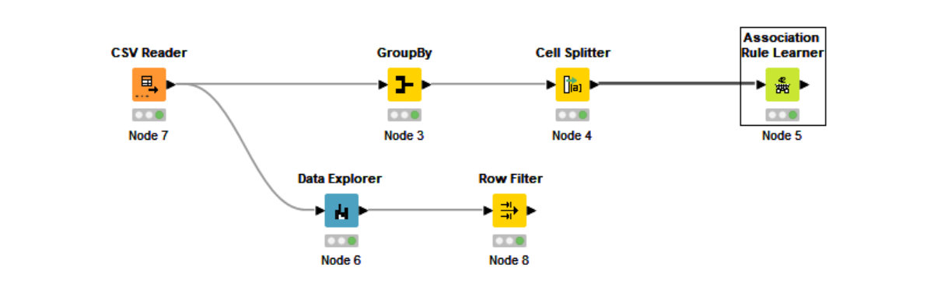
KNIME WORK-FLOW
Node Name | Description
Read CSV | Read the CSV file
Data Explorer | Explore the data parameters
Row Filter | To filter the “All-Purpose” value since this looks not relevant.
GroupBy | Group By Order ID
Cell Splitter | Convert the products data to set.
Association Rule Learner | Market Basket Analysis to generate the Frequent/Item List

Slide 14
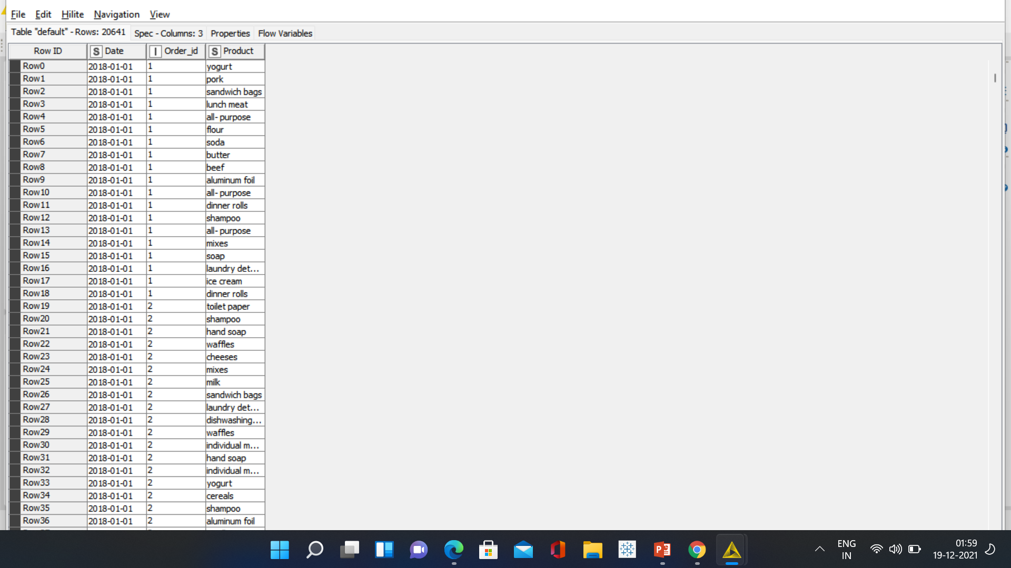
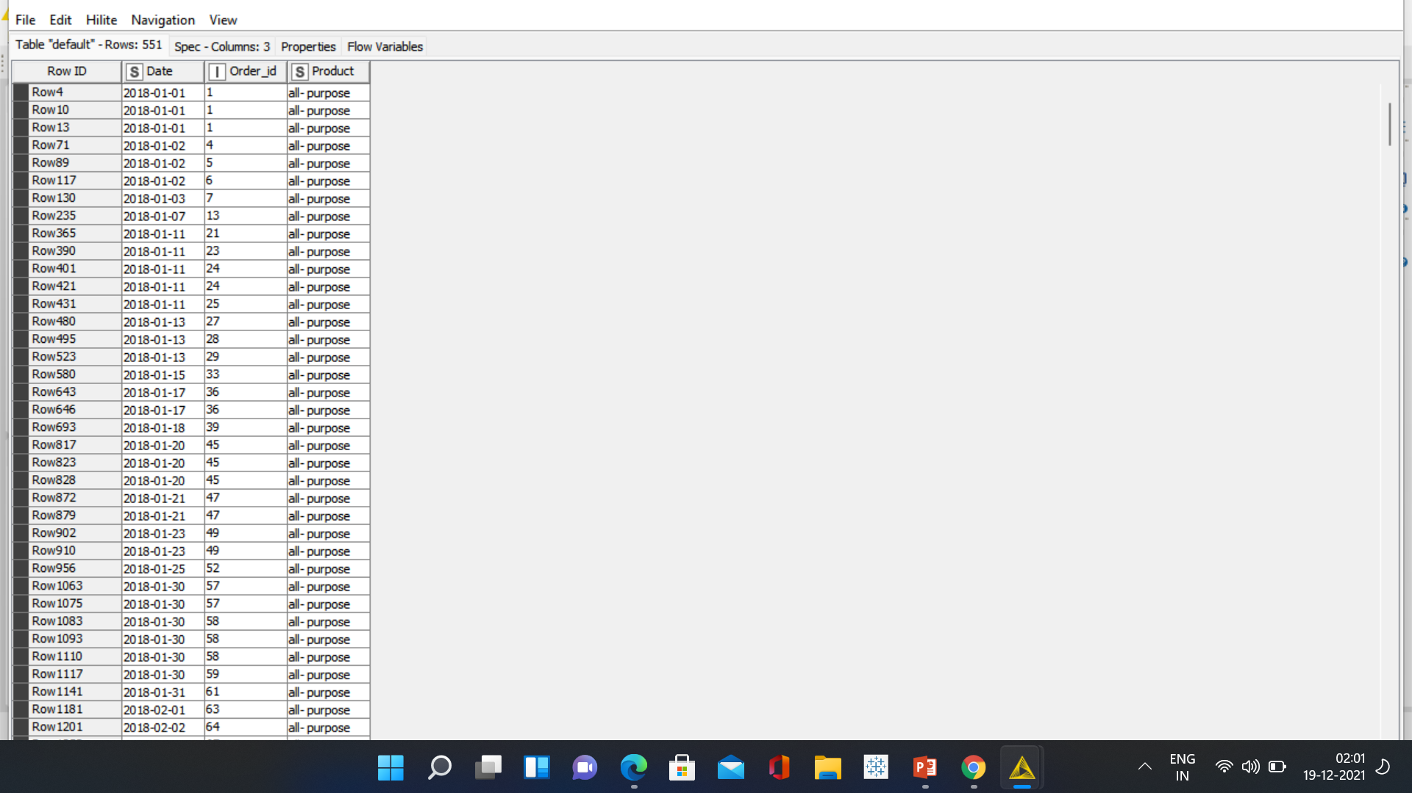
M B A – D ATA L O A D
We can observe here that no. of rows are now 551 as compared to our dataset it was 20,641, after filtering the data with out All-Purpose so 20,090 .
This will help us classify the products for our further Market Basket Analysis
Data Load | Filtered Data

Slide 15
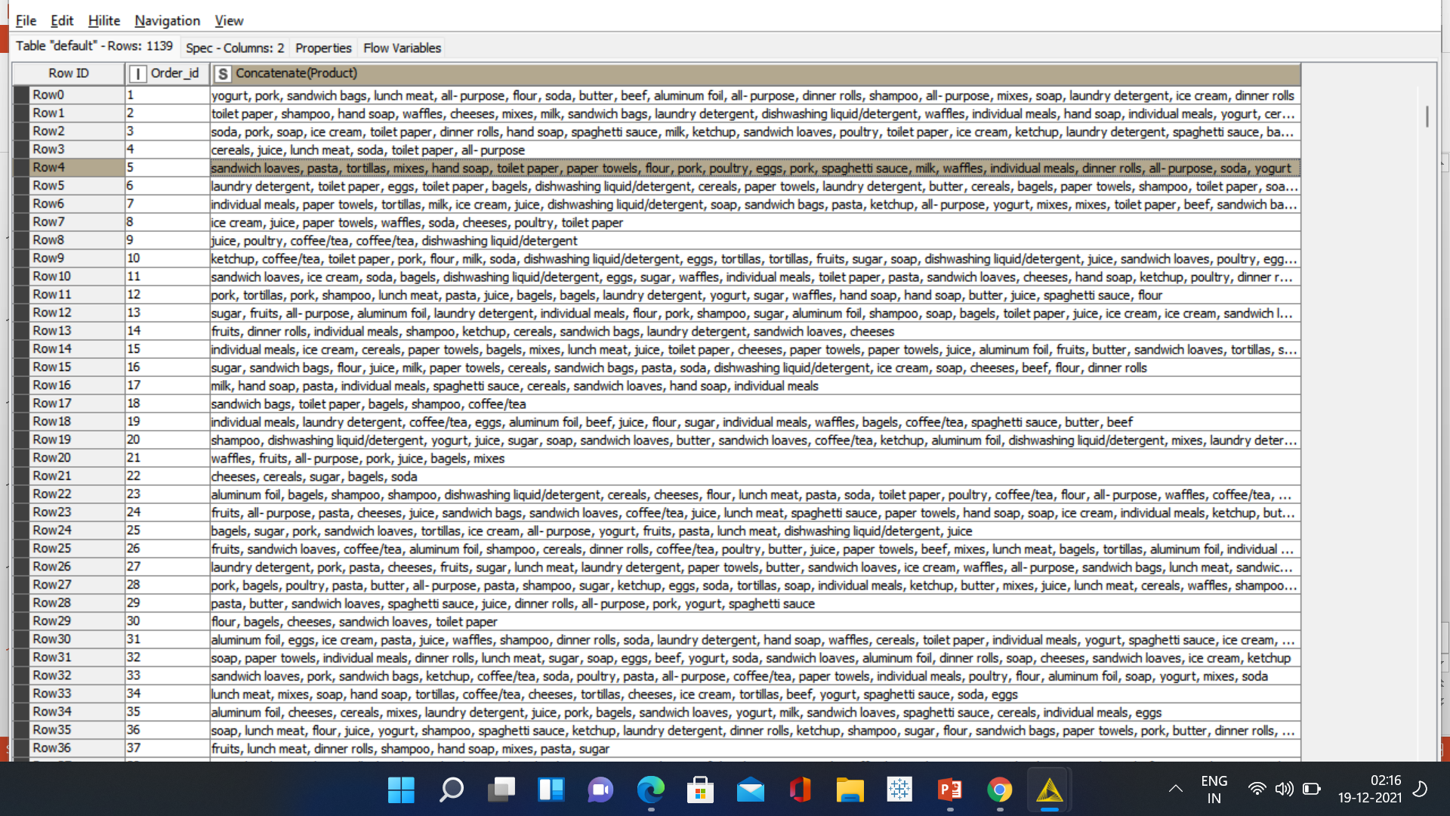
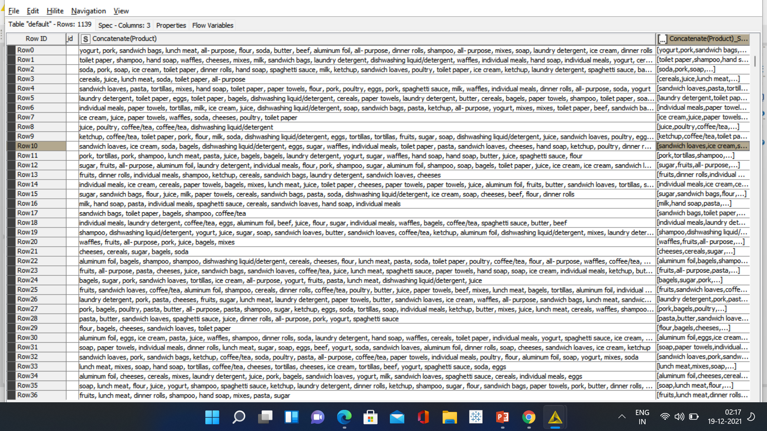
M B A – C E L L S P L I T T E R
The filtered data then grouped with Order ID and the unique values of 1139 rows.
Grouped Data
Convert Products to Set
>In this node ‘Cell Splitter’ we removed the duplicated products and concatenated them in a single group as per the purchase or order ID.
>This again helped us to classify the items in the set format which is in square bracket .

Slide 16
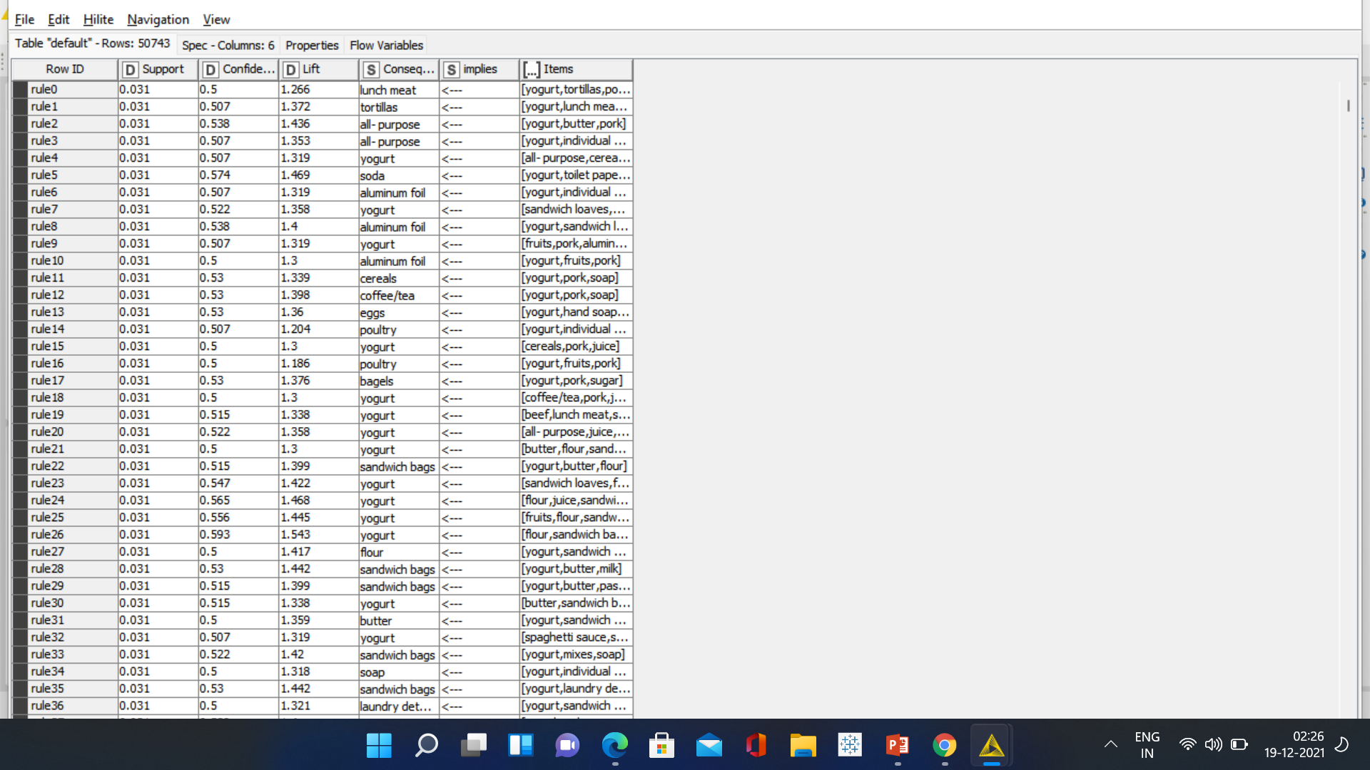
M B A – A S S O C I A T I O N R U L E
>These rules are actionable in that they can be used to target customers for marketing, or for product placing, or more generally to inform decision making. Examples of areas in which association rules have been used include: Supermarket purchases: common combinations of products can be used to inform product placement on supermarket shelves.
>This is the most important node for our Market Basket Analysis. We have here the three metrics that are Support, Confidence and Lift, we added a value to our Support which is between 0-1. We added value of 0.03 that is 3% sell of a product from overall transactions and we also selected the association rule for the minimum confidence as 0.05. So as you can see the values of confidence and support will help us to get threshold

Slide 17
I N F E R E N C E
So as we can see in the previous slide the table row shows 50743 records in which each row contains a different rules.
It has created multiple rules on the basis of threshold limit that we have set earlier in the association rule learner node and whichever has a higher lift value we recommend that product to the customer .
consequent column contains recommended products and we have sorted the lift values from higher to lower for the better recommendations.

Slide 18
INSIG HTS & RECOMM E NDATIO
If we see the result table of the Association Rule Learner some item are single as well as double and some are more in a single bracket.
So generally we recommend the products that are listed in consequent feature which has a higher lift value .
That means it has the higher probability of being purchased by the customer.

Slide 19
Thanks

